Slide 1
User Experience
Best Practices

Slide 2
The Butterfly Effect
Small Ripples, Big Problems

Slide 3

Complication Creates Stress
Discernment is taxing
Increased focus
Causes fatigue
Subtle but exponential
Leads to dissatisfaction
Affects your reputation beyond the application

Slide 4
Noise Pollution
Detracts from message
Harder to take away than to add
Question everything
Judicious white space

Slide 5
Feature Overload
Everything at fingertips, can’t grasp anything
Scope creep
Nicety vs. necessity
Power users will find power features

Slide 6
If It Walks Like a Duck and Talks Like a Duck
You Don’t Expect a Platypus

Slide 7
Expectations
Visual affordance
Cognitive breaks
Why is this different?
Resistant to change
Gain their trust

Slide 8
Conventions
Familiarity minimizes confusion
Perform tasks faster and more accurately
Can concentrate on what they want to do, not how to do it

Slide 9
A Place for Everything
And Everything in its Place

Slide 10
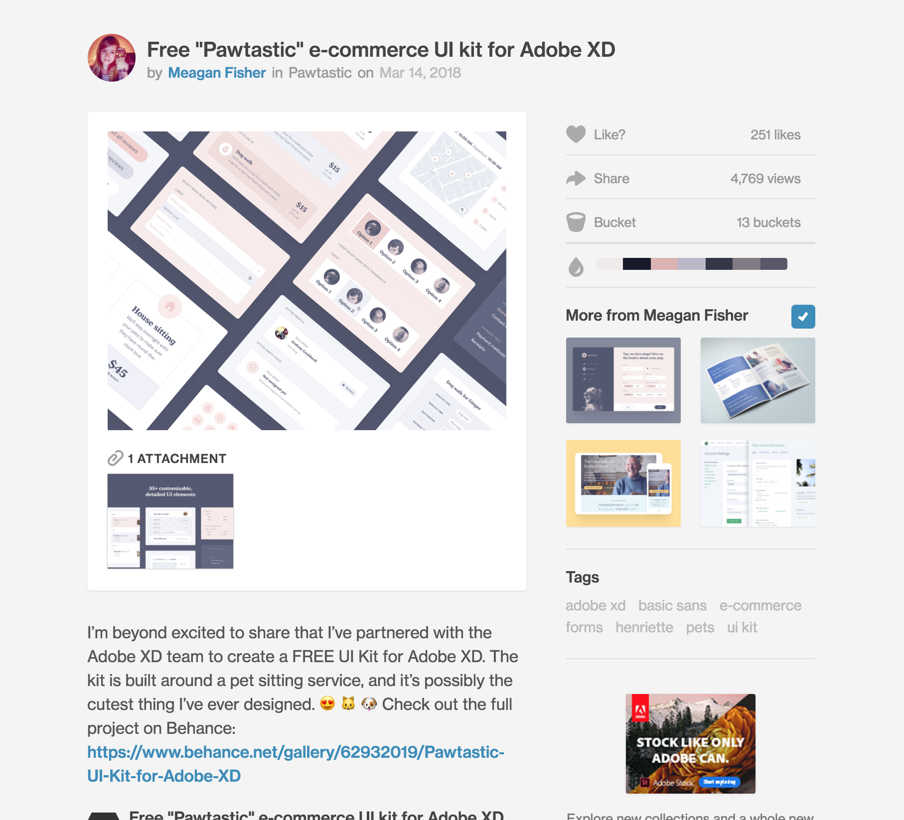
Logical Grouping
Navigation
Paneling
Primary content
Primary properties
Related content
Advertising
Notes:
http://www.uxbooth.com/articles/comics-and-ux-part-2-flow-and-content/
https://dribbble.com/shots/4344075-Free-Pawtastic-e-commerce-UI-kit-for-Adobe-XD

Slide 11
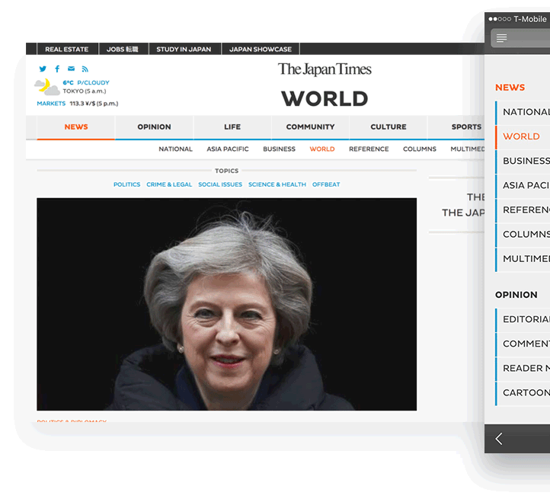
Hierarchy
Parent/child relationships
Cuts out irrelevant options
Navigational clues
Notes:
http://www.uxbooth.com/articles/the-rules-for-modern-navigation/
https://www.japantimes.co.jp/news/world/

Slide 12
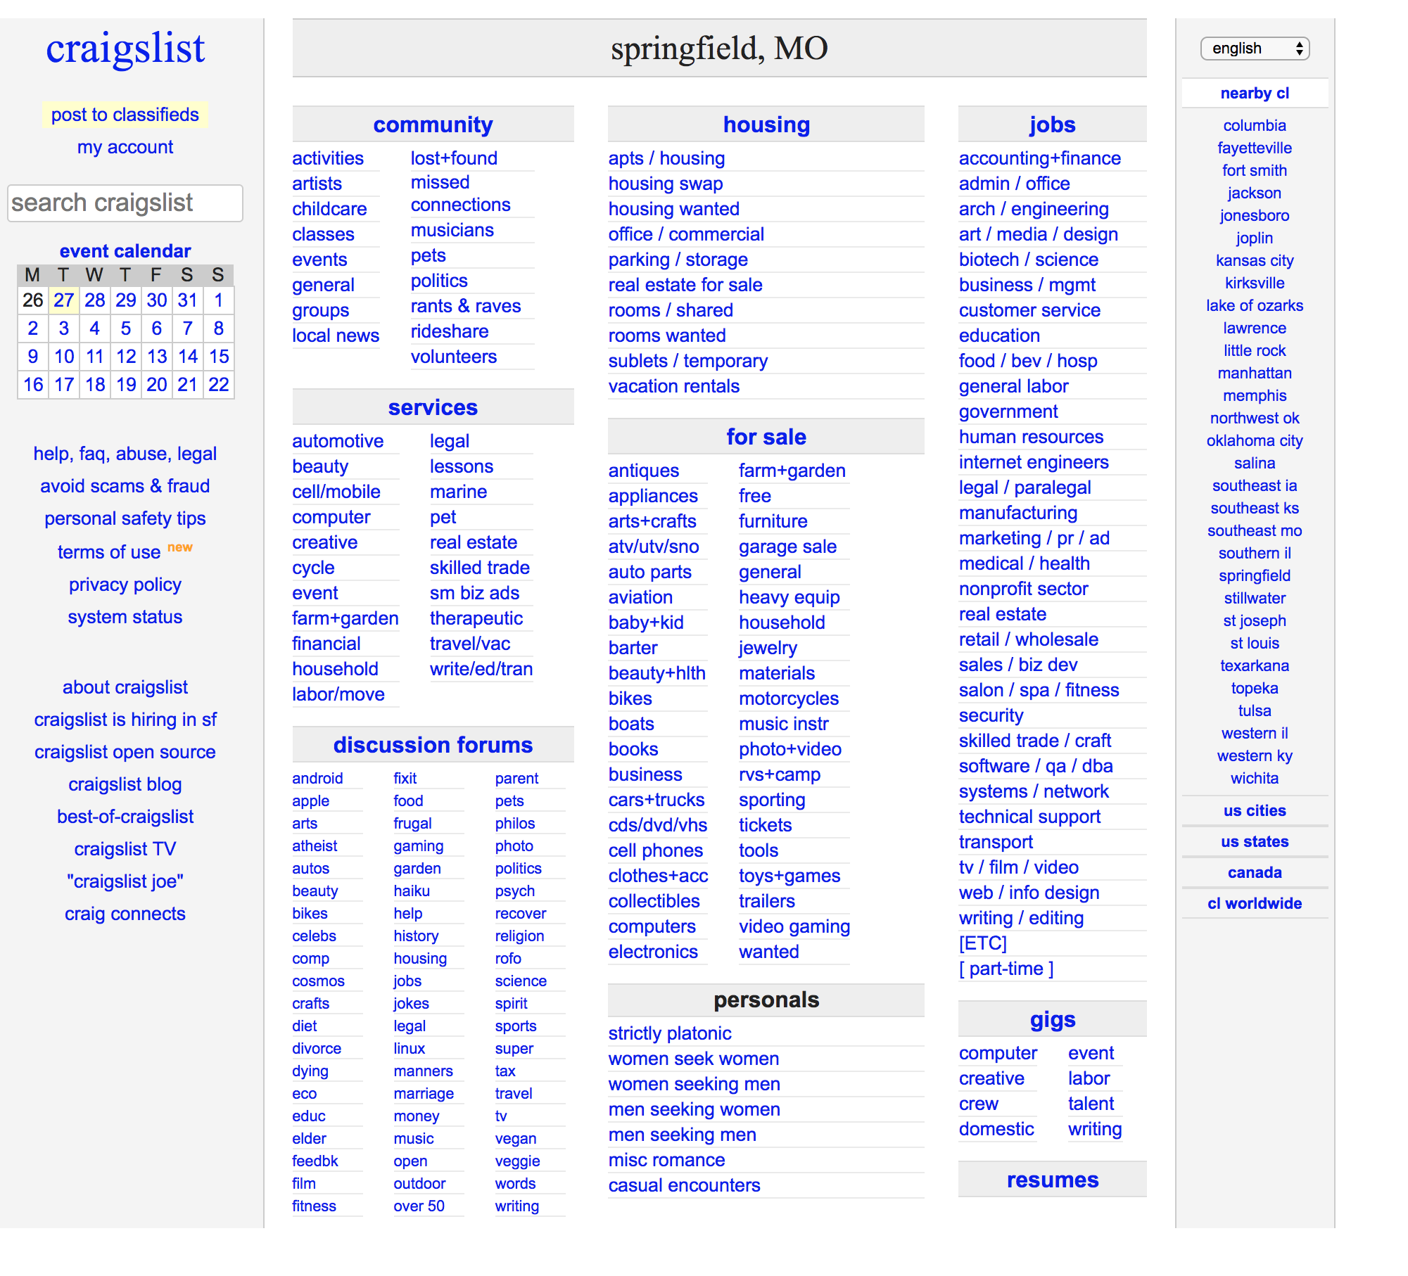
Prominence
Visual weight: size, color, depth, location, intensity, etc.
All bold = nothing bold
Can’t find it = doesn’t exist
Never rely on user’s memory
Notes:
http://www.uxbooth.com/articles/effective-presentation-of-a-websites-navigation/
https://springfield.craigslist.org/

Slide 13
Click here to advance to the next slide and learn why you need to wipe away “click here” links from the face of the earth like a new plague
A Personal Crusade

Slide 14
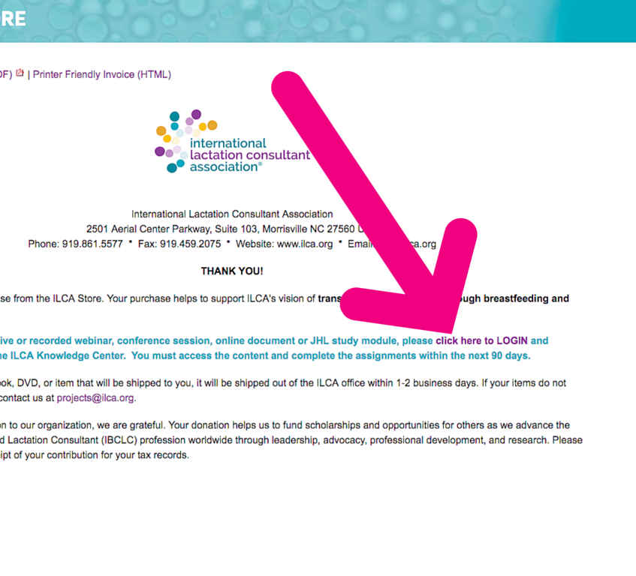
Never Click Here
Generic
Hard to find
Patronizing
Dated terminology
Small target area
Not accessibility friendly
Not SEO friendly
Not user friendly
Notes:
http://blog.visioninternet.com/why-click-here-links-are-bad
http://www.ilca.org/main/faq-pages/faq-purchase-item

Slide 15
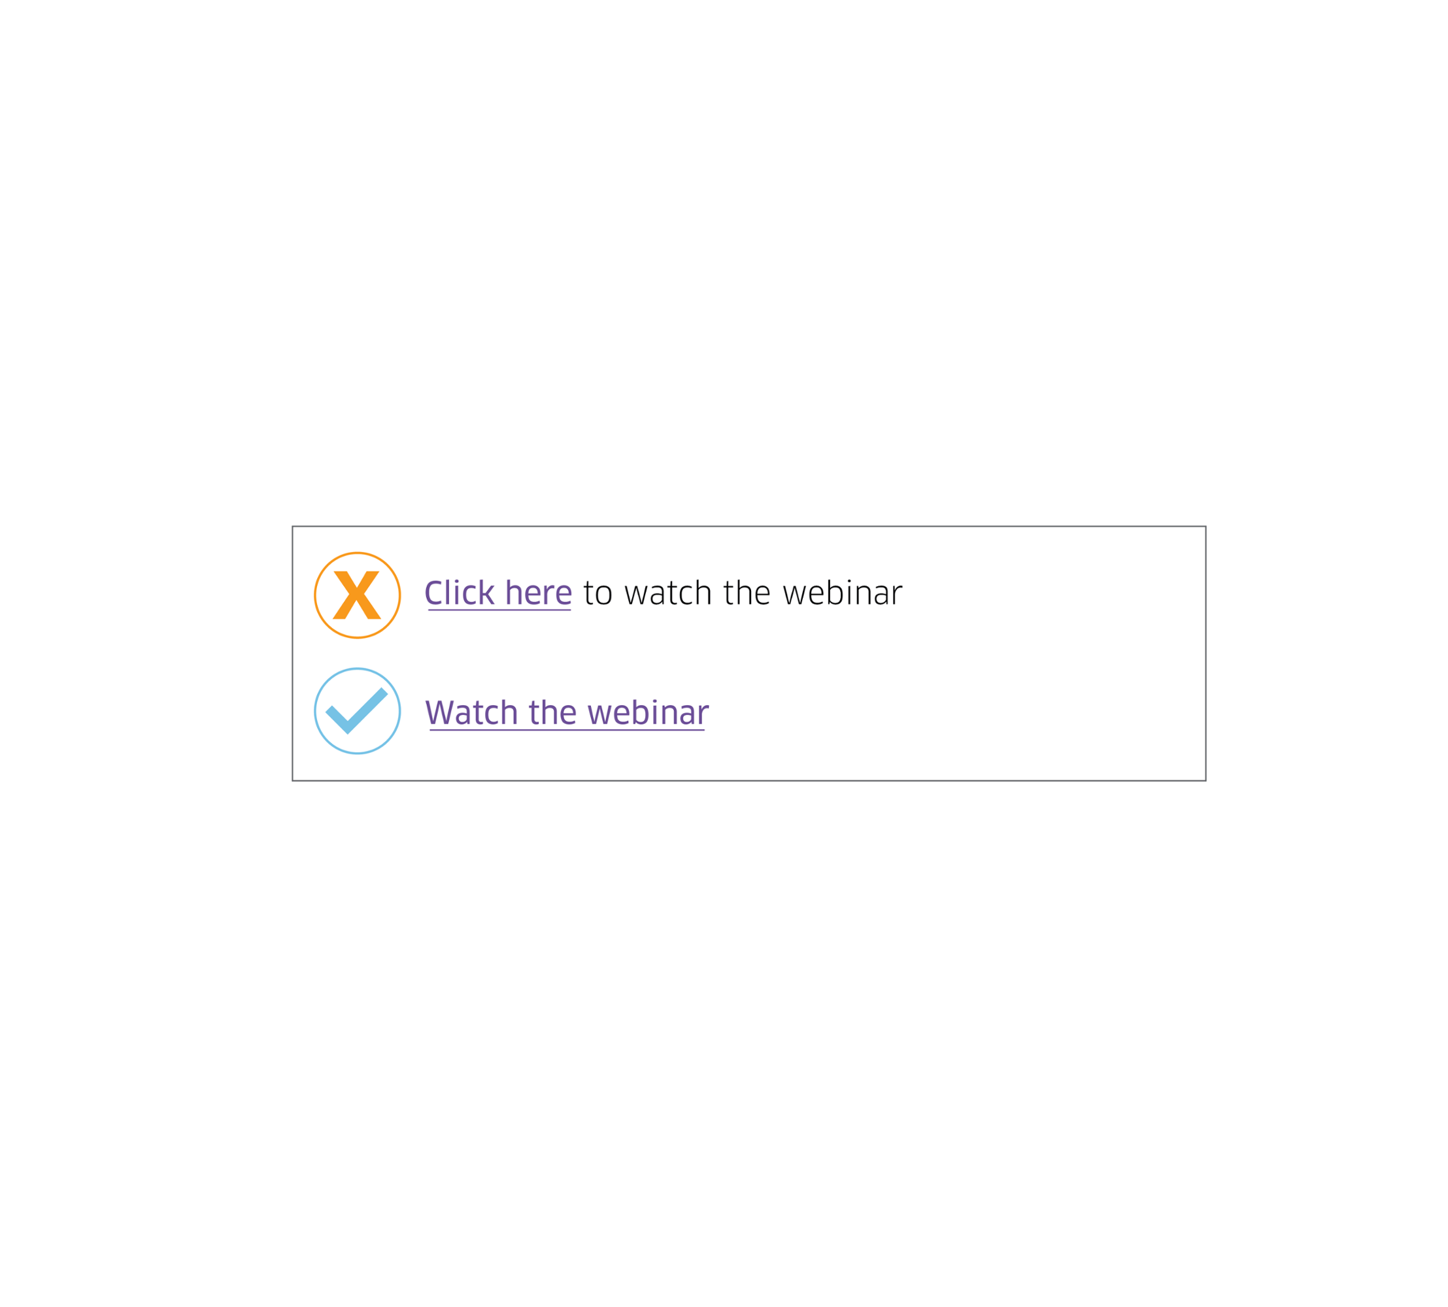
Calls to Action
Visually distinct
Describe the action/destination
Prominent location
Notes:
http://blog.visioninternet.com/why-click-here-links-are-bad

Slide 16
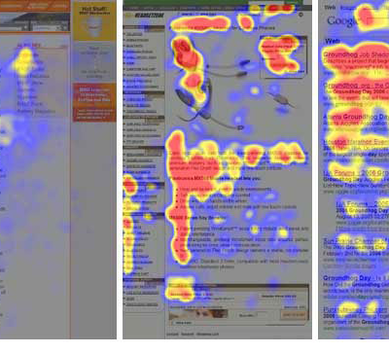
“F” Reading Pattern
Users look but don’t read
Front-load information carrying words
Use appropriate headings
Summarize at the beginning
Be brief but informative
Notes:
https://www.nngroup.com/articles/f-shaped-pattern-reading-web-content/

Slide 17
Anything You Can Do, I Can Do Better
Basic Usability Testing

Slide 18
Tunnel Vision
Make assumptions
Technical mindset
Different perspectives

Slide 19
Usability Tests, on the Cheap
Co-workers, friends, family
Fit target audience
Not directly involved in project
Hug for Mom, beer for friend, coffee for co-worker

Slide 20
Power to the People
Design to Get Out of Their Way

Slide 21
Stealth UX
“It just works”
Best UI compliment: pleased with their success
Never realize how hard it was to design/develop

Slide 22
Tone
Courteous
Helpful
Brief
Non-technical

Slide 23
User-Centric Design
Building something to make someone else’s life easier, happier, more enjoyable
What irks you, irks them too
Sweat the details

Slide 24
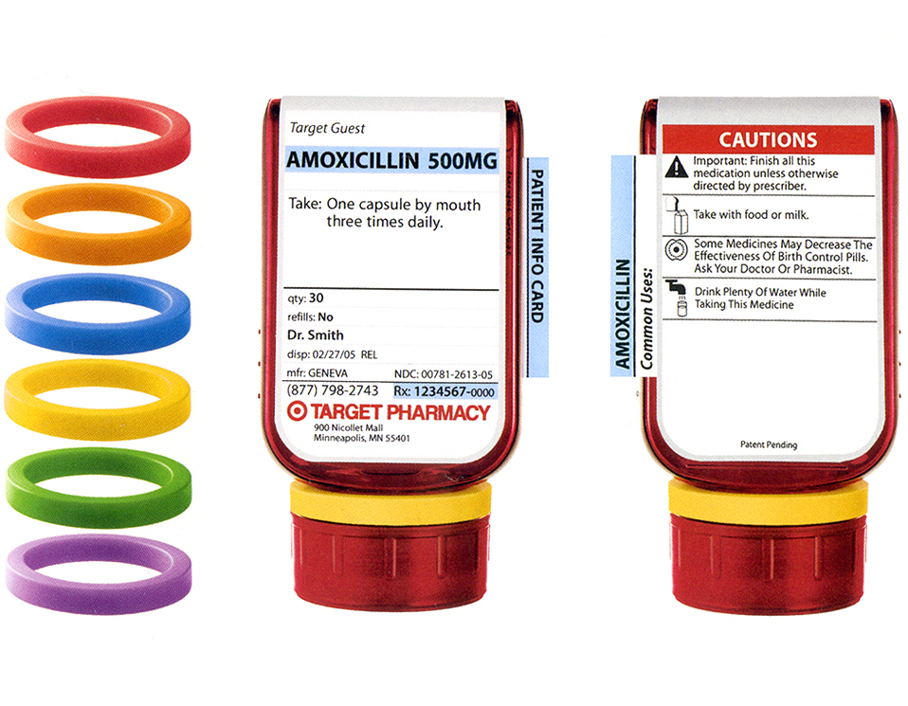
Design Is Everywhere
Alarm clocks
Medication labels
Doors
Light switches
Pathways in a park
Notes:
http://www.adlerdesign.com/project/clear-rx-medication-system/

